Slide 1
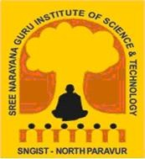
MINI PROJECT REPORT
ON
YOUTUBE HAND GESTURE CONTROL SYSTEM
Submitted
In partial fulfillment of the requirements for the award of the degree of
BACHELOR OF TECHNOLOGY IN
COMPUTER SCIENCE AND ENGINEERING
Of
APJ Abdul Kalam Technological University, Thiruvananthapuram
By
MUHAMMED RISHAN SGI21CS015
STEVE SANTHOSH SG21CS020 SUMAYYA P A SGI20CS021
DEPARTMENT OF COMPUTER SCIENCE AND ENGINEERING,
SNGIST GROUP OF INSTITUTIONS MANJALY P.O. , NORTH PARAVUR -683520

Slide 2
SNGIST GROUP OF INSTITUTIONS
MANJALY P.O. , NORTH PARAVUR- 683520
CERTIFICATE
Certified that the Project report entitled Hand Gesture YouTube Control System submitted by MUHAMMED RISHAN M R, Reg No. SGI21CS015, STEVE SANTHOSH, Reg No. SGI21CS020, SUMAYYA P A, Reg No. SGI21CS021 is the bonafide report of the project work done by them under my guidance, in partial fulfillment for the award of
Bachelor of Technology in Computer Science and Engineering of APJ Abdul Kalam Technological University, Thiruvananthapuram during the Academic year 2022-23.
Submitted for the practical examination conducted on ………………
GUIDE
PROJECT COORDINATOR
HOD
External Examiner
Date:

Slide 3
Hand Gesture YouTube Control System
DECLARATION
We undersigned hereby declare that the project report “Hand Gesture YouTube Control System”, submitted for partial fulfilment of the requirements for the award of degree of Bachelor of Technology of the APJ Abdul Kalam Technological University, Thiruvananthapuram, Kerala is a bonafide work done by us under supervision of Ms. Anju Raveendran, HOD, Dr. Reshmi G Nair, Project Coordinator and Ms. Anagha Pradeep, Project Guide .This submission represents our ideas in our own words and where ideas or words of others have been included, we have adequately and accurately cited and referenced the original sources. We also declare that we have adhered to ethics of academic honesty and integrity and have not misrepresented or fabricated any data or idea or fact or source in our submission. We understand that any violation of the above will be a cause for disciplinary action by the institute or the university and can also evoke penal action from the sources which have thus not been properly cited or from whom proper permission has not been obtained. This report has not been previously formed the basis for the award of any degree, diploma, or similar title of any other university.
Place:
Signature:
Date:
MUHAMMED RISHAN MR
(SGI21CS015)
STEVE SANTHOSH
(SGI21CS020)
SUMAYYA P A
(SGI21CS021)

Slide 4
Hand Gesture YouTube Control System
i
ACKNOWLEDGEMENT
The satisfaction that accompanies that the successful completion of any task would be incomplete without the mention of people whose ceaseless cooperation made it possible, whose constant guidance and encouragement crown all efforts with success. We would like to express our deepfelt gratitude to GOD Almighty for showing his grace upon us, without which our dissertation Hand Gesture YouTube Control System would not have materialized.
We are grateful to the Chairperson, Mr. Asprasad V P and Management of SNGIST Group of Institutions for providing thepfacilities for the completion of our task.
Our profound gratitude and sincere thanks to Dr. Sagini Thomas Mathai, Principal, SNGIST Group of Institutions for the support and encouragement to carry out this project. We would also like to thank Ms. Anju Raveendran, Head of the Department of Computer Science and Engineering for her inspiration and guidance. May we express our heartfelt thanks to Dr. Reshmi G Nair, Project Coordinator and Ms. Anagha Pradeep, Project Guide for their valuable guidance and advice related to this project.
We thank all the faculty members of the Department of Computer Science and Engineering for all the help extended to us and for motivating us. We also extend our gratitude to technical staff in the Lab, for all their support and help.
We are grateful to the management of SNGIST group of Institutions for providing us with the facilities for the task.
We, on this occasion, remember the valuable support and prayers offered by our family members and friends which were indispensable for the successful completion of this work.

Slide 5
Hand Gesture YouTube Control System
ii
ABSTRACT
The Gesture Control for YouTube application utilizes a combination of hand tracking, image processing and machine learning technique to enable hands-free control of YouTube videos through hand gestures.
The application uses computer visual algorithms, specifically the OpenCV library and the cvzone. HandTrackingModule, to detect and track the user’s hand in real-time. It analyses the video feed from a webcam and identifies the hand’s position, movements and other relevant information.
It is a trained machine learning model, implemented using the cvzone. ClassificationModule, is employed to recognize different hand gestures. The model has been trained on labelled data, enabling it to classify gestures such as “Free Hand”, “Right”, “Left”, “Volume Up”, “Volume Down”, etc. Once the application recognizes a specific hand gesture, it triggers the corresponding action for YouTube playback control. These actions are simulated using pyautogui library, which emulates keyboard input.
This abstract outlines the underlying principles, implementation strategies, and potential applications of the hand gesture YouTube controller, highlighting its significance in the realm of human-computer interaction and multimedia consumption.

Slide 6
Hand Gesture YouTube Control System
iii
CONTENTS
1. INTRODUCTION | 1
2. WORK PLAN | 2
3. LITERATURE SURVEY | 3
3.1 gesture works | 3
3.2 VLC Media Player with libHandWave | 4
3.3 Kinect for Windows SDK | 5
4. OBJECTIVE | 6
5. TECHNOLOGY USED | 7
6. FORMULATION OF DESIGN 6.1 INSTRUCTIONS 6.2 MODULE DESCRIPTION 6.3 UML DIAGRAM | 14 14 15 16
7. SAMPLE CODE | 17
8. SCREENSHOTS | 22
9. CONCLUSION | 25
10. FUTURE ENHANCEMENT | 26
11. REFERENCES | 28

Slide 7
Hand Gesture YouTube Control System
iv
LIST OF FIGURES
FIGURE NUMBER | FIGURE NAME | PAGE NUMBER
Figure 1 | Screenshot 1 | 22
Figure 2 | Screenshot 2 | 22
Figure 3 | Screenshot 3 | 22
Figure 4 | Sample slide 1 | 23
Figure 5 | Sample slide 2 | 23
Figure 6 | Sample slide 3 | 24
Figure 7 | Screenshot 4 | 24

Slide 8
Hand Gesture YouTube Control System
1
In an era where human-computer interaction has evolved to be more intuitive and efficient, the Hand Gesture Recognition and Control System stands as a pioneering endeavor to bridge the physical and digital worlds through natural, non-verbal communication. Leveraging computer vision and machine learning techniques, this project strives to empower users to interact with computers seamlessly using hand gestures.
The Gesture Control for YouTube project introduces an innovative solution for hands-free control of YouTube videos using hand gestures. This computer vision-based application combines hand tracking and gesture recognition techniques to enable users to interact with YouTube playback intuitively and effortlessly.
By leveraging the power of computer vision and machine learning, the application tracks and detects the user's hand movements in real-time. It then applies a trained classification model to recognize and interpret specific hand gestures. These gestures encompass a range of controls such as adjusting volume, playing/pausing videos, entering/exiting fullscreen mode, and skipping forward/rewinding
This project allows users to control YouTube videos using hand gestures. By leveraging computer vision and machine learning techniques, the project captures hand movements through a webcam and translates them into commands that interact with YouTube. Whether you want to adjust the volume, navigate through the video, or enter full-screen mode, this project enables intuitive control using your hands.
1. INTRODUCTION

Slide 9
Hand Gesture YouTube Control System
2
2. WORK PLAN
CONTENTS | DATE OF COMPLETION
Literature review
Methodology | 02/03/2024-13/03/2024
1.Familiarisation of python | 02/03/2024
2.Familiarisation of tensorflow | 05/03/2024
3.Familiarisation of pyauotogui | 08/03/2024
4.Familiarisation of opencv | 11/03/2024
5.Familiarisation of mediapipe | 13/03/2024
Design | 14/03/2024-01/04/20234
1.User interface design | 28/03/20234
2.Model design | 01/04/2024
Coding Phase | 08/04/2024-24/04/2024
Testing Phase | 25/04/2024-6/05/2024
1.System testing | 25/04/2024
2.Unit Testing | 27/04/2024
3.Integration Testing | 30/04/2024
4. User Acceptance Testing | 06/05/2024
Future Enhancement | 6/05/2024
Project Completion | 7/05/2024

Slide 10
Hand Gesture YouTube Control System
3
3. LITERATURE SURVEY
3.1 GestureWorks
GestureWorks is a software platform that allows developers to create gesture-based interactions for various applications, including media players. It provides tools and libraries to integrate hand gesture recognition and control into custom software solutions. It provides developers with a set of tools, libraries, and APIs (Application Programming Interfaces) that allow them to create interactive experiences for touch-enabled devices such as smartphones, tablets, and touchscreens.
Advantages
Customizable Gestures: Tailored gestures enhance user experience.
Cross-Platform Compatibility: Supports multiple operating systems for wider accessibility.
Documentation and Support: Extensive resources aid integration and troubleshooting.
Scalability: Adaptable to projects of various sizes.
Disadvantages
Learning Curve: Steep for developers unfamiliar with gesture tech.
Cost: Licensing fees may pose a barrier, especially for smaller projects.
Hardware Dependency: Specific hardware requirements limit compatibility.
Performance Optimization: Challenges exist in optimizing for responsiveness and efficiency.

Slide 11
Hand Gesture YouTube Control System
4
3.2 VLC Media Player with libHandWave
VLC media player, a popular open-source media player, has experimented with integrating gesture control using libraries like libHandWave. This allows users to control media playback through hand gestures, though it may require some technical setup and customization.VLC Media Player is a popular open-source multimedia player that supports various audio and video formats. However, as of my last update, there isn't any native integration of libHandWave with VLC. LibHandWave is a library that enables gesture recognition using a depth-sensing camera like the Microsoft Kinect or Intel RealSense.
Advantages
Gesture Control: Enhances user experience by allowing intuitive media playback control.
2Customization: Users can personalize gestures and mappings to suit their preferences.
3.Open-Source: Promotes community collaboration and innovation.
4.Accessibility: Provides an accessible control option for users with physical limitations.
Disadvantages
Technical Setup: Requires technical expertise for setup and configuration.
Compatibility Issues: May encounter compatibility problems with certain hardware or OS.
Limited Gestures: Gesture range and recognition may be restricted.
Reliability: Performance inconsistencies and glitches may occur.

Slide 12
Hand Gesture YouTube Control System
5
3.3 Kinect for Windows SDK
The Kinect for Windows SDK includes features for recognizing and tracking hand gestures using the Kinect sensor. Developers can utilize this SDK to create applications, including media players, that respond to hand gestures for control.The Kinect for Windows SDK is a software development kit released by Microsoft that enables developers to create applications that utilize the capabilities of the Kinect sensor for Windows. It provides APIs and tools for integrating gesture recognition, body tracking, voice recognition, and other features into Windows applications.
Advantages
Depth Sensing: Enables accurate tracking of three-dimensional hand gestures.
Wide Gesture Range: Supports various gestures like waving, pointing, and swiping.
Integration: Easily integrates with existing platforms like Windows applications and Unity.
Accessibility: Facilitates interaction without physical contact, enhancing accessibility
Disadvantages
Hardware Dependency: Requires specific Kinect sensor hardware.
Processing Requirements: Demands significant processing power for real-time tracking.
Learning Curve: Presents challenges for developers new to depth-sensing technology.
Cost: Kinect hardware acquisition may be costly, affecting project feasibility.

Slide 13
Hand Gesture YouTube Control System
6
The objective of a YouTube hand gesture control system is to enable users to interact with YouTube videos using hand gestures instead of traditional input devices like keyboards or mice. This system aims to enhance user experience by providing a more intuitive and immersive way to navigate and control video playback.
Key objectives of such a system may include:
Enhanced User Experience: Providing users with a more natural and intuitive way to interact with YouTube videos can enhance their overall viewing experience.
Accessibility: Hand gesture control can make YouTube more accessible to individuals with disabilities or impairments that may make traditional input methods challenging.
Hands-free Interaction: Users can control video playback, volume, playback speed, and other features without needing to physically touch a device, which can be convenient in various situations, such as when cooking or exercising.
Innovation: Introducing novel interaction methods like hand gesture control demonstrates innovation and can attract users who are interested in cutting-edge technology.
Gesture Recognition Technology Development: Developing a YouTube hand gesture control system involves advancements in gesture recognition technology, which can have broader applications beyond YouTube, such as in gaming, virtual reality, and healthcare.
4. OBJECTIVE

Slide 14
Hand Gesture YouTube Control System
7
5. TECHNOLOGY USED
Python:
Python is a high-level, interpreted programming language that has gained widespread popularity for its simplicity and readability. It was conceived by Guido van Rossum and first introduced in 1991. From the outset, Python was designed to prioritize ease of use, making it accessible to programmers of all skill levels. Its syntax is straightforward and intuitive, emphasizing clarity and reducing the amount of boilerplate code necessary for common tasks.
One of Python's defining characteristics is its interpretive nature. Instead of compiling code into machine language before execution, Python code is executed line by line by the Python interpreter. This approach facilitates rapid development and testing, as changes to the code can be immediately executed and observed. Additionally, Python is dynamically typed, meaning variable types are determined at runtime, which contributes to its flexibility and ease of use.
Python boasts an extensive standard library that provides built-in support for a wide range of functionalities, such as file input/output operations, networking, and data manipulation. This comprehensive library reduces the need for developers to reinvent the wheel and simplifies the implementation of common tasks.

Slide 15
Hand Gesture YouTube Control System
8
Furthermore, Python's ecosystem is enriched by a plethora of third-party libraries and frameworks catering to various domains and applications. Whether it's web development (e.g., Django, Flask), data science (e.g., NumPy, of resources and tools to suit virtually any programming needPandas), machine learning (e.g., TensorFlow, PyTorch), or beyond, Python offers a wealth .
Python's cross-platform compatibility is another key advantage, as it can be deployed on a variety of operating systems, including Windows, macOS, and various Unix-like systems. This portability ensures that Python applications can run seamlessly across different environments, maximizing their reach and usability.
Moreover, Python benefits from a vibrant and supportive community of developers who actively contribute to its development, provide assistance through forums and online communities, and create open-source projects and libraries. This collaborative ethos has played a significant role in Python's continued growth and evolution as a versatile and powerful programming language.
In summary, Python's combination of simplicity, versatility, extensive library support, cross-platform compatibility, and vibrant community make it a preferred choice for a wide range of programming tasks, from simple scripting to complex software development projects. Its user-friendly design and robust ecosystem continue to attract new users and solidify its position as one of the most popular programming languages in the world.

Slide 16
Hand Gesture YouTube Control System
9
Libraries and Modules: Your project's requirements specify specific versions
of libraries and modules:
Cvzone :
Computer vision library used for hand tracking and gesture recognition
Firstly, in the realm of technology and artificial intelligence, "CV" typically stands for "Computer Vision." A CV Zone in this context would likely refer to a specialized area or domain focused on computer vision applications. Computer vision involves teaching computers to interpret and understand the visual world, enabling tasks such as object recognition, image classification, and image segmentation. A CV Zone could encompass research, development, and applications of computer vision technology, exploring areas such as machine learning algorithms, image processing techniques, and real-world applications in fields like autonomous vehicles, medical imaging, and surveillance systems.
Secondly, "CV" can also stand for "Curriculum Vitae," which is a document summarizing an individual's education, work experience, skills, and achievements. In this context, a CV Zone might refer to a specific section or platform dedicated to creating, editing, or sharing CVs. Such a zone could provide tools and resources for job seekers to craft compelling CVs that effectively highlight their qualifications and experiences. It might offer templates, tips, and guidance on structuring and formatting CVs tailored to different industries and positions, helping individuals present themselves professionally and stand out to potential employers.
Without further context, it's challenging to determine the specific meaning of

Slide 17
Hand Gesture YouTube Control System
10
"CV Zone." However, these two interpretations cover common uses of the term in technology and professional contexts. If you have a particular context or usage in mind, providing additional details would enable a more precise explanation.
Mediapipe :
Library for hand detection and tracking.
Mediapipe is an open-source framework developed by Google that facilitates the building of machine learning pipelines for various perceptual tasks, including but not limited to hand tracking, pose estimation, facial recognition, and object detection. It provides a comprehensive set of pre-built components and tools for processing and analyzing multimedia data, such as video streams and images, making it easier for developers to integrate machine learning models into their applications.
Mediapipe offers a modular and flexible architecture, allowing developers to construct complex pipelines by connecting different components, known as "graphs," together. These graphs can include components for tasks like data preprocessing, feature extraction, model inference, and post-processing. Additionally, Mediapipe provides optimized implementations of common computer vision and machine learning algorithms, ensuring efficient performance across various devices, including CPUs, GPUs, and specialized accelerators like Google's Edge TPU.
One of the notable features of Mediapipe is its emphasis on real-time performance and accuracy, making it suitable for applications requiring low latency and high precision, such as augmented reality, gesture recognition, and video analytics. Furthermore, Mediapipe offers support for both desktop and mobile platforms, enabling developers to deploy their applications across a wide range of devices and operating systems.

Slide 18
Hand Gesture YouTube Control System
11
Overall, Mediapipe simplifies the development of machine learning-based perceptual applications by providing a unified framework with pre-built components, optimized algorithms, and support for real-time performance. Its flexibility, scalability, and cross-platform compatibility make it a popular choice for developers working on a variety of multimedia-related projects.
opencv-python :
OpenCV, short for Open Source Computer Vision Library, is an open-source computer vision and machine learning software library. It provides a wide range of functionalities for tasks such as image and video analysis, object detection and tracking, facial recognition, and machine learning-based classification.
Originally developed by Intel in the late 1990s, OpenCV has since become one of the most popular and widely used libraries in the field of computer vision. It is written in C++ and optimized for performance, with bindings available for various programming languages, including Python, Java, and MATLAB, making it accessible to a broad audience of developers.
OpenCV offers a comprehensive collection of over 2500 optimized algorithms, which can be used to perform various tasks in computer vision and image processing. These algorithms cover a wide range of functionalities, including image filtering, feature detection and matching, geometric transformations, object segmentation, and camera calibration.
One of the key strengths of OpenCV is its versatility and compatibility across different platforms and operating systems. It supports Windows, macOS, Linux, Android, and iOS, allowing developers to build applications for desktop, mobile, and embedded devices.OpenCV is widely used in academia, research, and industry for applications such as robotics, augmented reality, autonomous vehicles, medical imaging, surveillance systems, and more.

Slide 19
Hand Gesture YouTube Control System
12
Its extensive documentation, active community, and continuous development
make it a valuable resource for anyone working in the field of computer vision
and image processing.
Tensorflow :
Machine learning framework for gesture classification.
TensorFlow is an open-source machine learning framework developed by the Google Brain Team, offering a powerful ecosystem for constructing and deploying machine learning models, especially neural networks. Central to TensorFlow is its ability to represent computations as computational graphs, where nodes denote mathematical operations and edges signify the flow of data between operations. This graph-based approach facilitates efficient handling of complex computations across different hardware platforms, including CPUs, GPUs, and specialized accelerators like TPUs (Tensor Processing Units). TensorFlow's versatility is further enhanced by its high-level APIs, such as Keras, which enable users to easily build and train neural networks while maintaining flexibility for advanced customization. It supports a broad spectrum of machine learning tasks, ranging from deep learning applications like image classification and natural language processing to traditional machine learning algorithms such as linear regression and support vector machines. TensorFlow also provides robust deployment tools like TensorFlow Serving, TensorFlow Lite, and TensorFlow.js, allowing models to be deployed in production environments, mobile devices, and web browsers. With its rich ecosystem and performance optimization, TensorFlow remains a leading choice for researchers, developers, and engineers seeking to create and deploy cutting-edge machine learning models across diverse domains and applications.

Slide 20
Hand Gesture YouTube Control System
13
Pyautogui :
Library for simulating keypresses and mouse movements.
PyAutoGUI is a Python library that enables automation of GUI (Graphical User Interface) interactions. It allows users to control the mouse and keyboard to automate repetitive tasks, simulate user input, and interact with windows and controls programmatically. PyAutoGUI is platform-independent and works on Windows, macOS, and Linux operating systems.
With PyAutoGUI, developers can automate various tasks such as clicking on buttons, entering text into input fields, moving the mouse cursor, and performing keyboard actions like typing, pressing keys, and hotkeys. This automation can be useful for tasks like GUI testing, GUI-based application automation, creating bots for games or web scraping, and automating workflows in desktop applications. PyAutoGUI provides a simple and intuitive API for controlling GUI interactions. It includes functions for mouse movements, clicks, and scrolling, as well as keyboard actions like typing, pressing keys, and sending hotkeys. Additionally, PyAutoGUI offers features for taking screenshots, locating images on the screen, and controlling the mouse and keyboard with pixel accuracy.
Overall, PyAutoGUI is a valuable tool for automating GUI interactions in Python scripts, making it easier to perform repetitive tasks and streamline workflows in desktop applications across different operating systems.

Slide 21
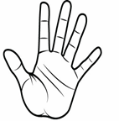




Hand Gesture YouTube Control System
14
6. FORMULATION OF DESIGN
6.1 INSTRUCTIONS
Command | Image | Function
Free Hand |  | Do Nothing
Start or Stop |  | Start or stop the YouTube video
Volume Up |  | Increase the volume of the YouTube video
Volume Down |  | Decrease the volume of the YouTube video
Full-Screen Mode |  | Enter full-screen mode for the YouTube video

Slide 22

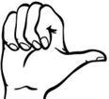
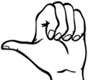
Hand Gesture YouTube Control System
15
Exit Full-Screen Mode |  | Exit full-screen mode for the YouTube video
Skip Right by 5 seconds |  | Skip forward by 5 seconds in the YouTube video
Skip Left by 5 seconds |  | Skip backward by 5 seconds in the YouTube video
6.2 MODULE DESCRIPTION
Hardware description • Processor: i3 or above
• Ram: 2GB (min)
• System memory: 8GB (min)
•Network connection: UTP or coaxial cable connection Software description
• Technology implemented:AI and ML
• Language used: Python
• User interface:VS code

Slide 23
Hand Gesture YouTube Control System
16
6.3 UML DIAGRAM
User
Webcam
maxHands
findHands()
ImageCapture
capture()
HandDetection
detectHands()
ActionExecution
executeAction()
Classifier
- modelPath
- labelsPath
getPrediction()

Slide 24
Hand Gesture YouTube Control System
17
7. SAMPLE CODE
import cv2
from cvzone.HandTrackingModule import HandDetector
from cvzone.ClassificationModule import Classifier
import numpy as np
import math
import time
import pyautogui
cap = cv2.VideoCapture(0)
detector = HandDetector(maxHands=1)
classifier = Classifier('D:/Mini Project/YoutubeControl/Model/keras_model.h5', 'D:/Mini Project/YoutubeControl/Model/labels.txt')
offset = 20
imgSize = 300
counter = 0
labels = ["free_hand","right","left", "v_up","v_down","max","min","stop"]
control_delay = 5 # Delay in seconds before performing another control action
last_action_time = time.time() - control_delay

Slide 25
Hand Gesture YouTube Control System
18
while True:
success, img = cap.read()
imgOutput = img.copy()
hands, img = detector.findHands(img)
if hands:
hand = hands[0]
x, y, w, h = hand['bbox']
imgWhite = np.ones((imgSize, imgSize, 3), np.uint8) * 255
imgCrop = img[y - offset: y + h + offset, x - offset: x + w + offset]
if imgCrop.size == 0:
print("Empty image crop. Skipping frame.")
continue
aspectRatio = h / w
if aspectRatio > 1:
k = imgSize / h
wCal = math.ceil(k * w)
imgResize = cv2.resize(imgCrop, (wCal, imgSize))
imgResizeShape = imgResize.shape
wGap = math.ceil((imgSize - wCal)
/ 2)
imgWhite[:, wGap:wCal + wGap] = imgResize

Slide 26
Hand Gesture YouTube Control System
19
prediction, index = classifier.getPrediction(imgWhite, draw=True)
print(prediction, ":", index)
else:
k = imgSize / w
hCal = math.ceil(k * h)
imgResize = cv2.resize(imgCrop, (imgSize, hCal))
imgResizeShape = imgResize.shape
hGap = math.ceil((imgSize - hCal) / 2)
imgWhite[hGap:hCal + hGap, :] = imgResize
prediction, index = classifier.getPrediction(imgWhite, draw=True)
print(prediction, ":", index)
cv2.rectangle(imgOutput, (x - offset,
y - offset - 50), (x - offset + 90, y –
offset - 50 + 50), (255, 0, 255),
cv2.FILLED)
cv2.putText(imgOutput, labels[index], (x, y - 20), cv2.FONT_HERSHEY_COMPLEX, 1.7, (255, 255, 255), 2)
cv2.rectangle(imgOutput, (x - offset,
y - offset), (x + w + offset, y + h + offset)
, (255, 0, 255), 4)
cv2.imshow("ImageCrop", imgCrop)

Slide 27
Hand Gesture YouTube Control System
20
cv2.imshow("ImageWhite", imgWhite)
# Perform YouTube controls based on
the predicted label
current_time = time.time()
if labels[index] == "v_up" :
pyautogui.press("up") # Press up arrow key for volume up
last_action_time = current_time
elif labels[index] == "v_down":
pyautogui.press("down") # Press down arrow key for volume down
last_action_time = current_time
elif labels[index] == "free_hand":
pass # Do nothing for the "free_hand" gesture
elif labels[index] == "stop" and current_time - last_action_time >= control_delay:
pyautogui.press("space") # Press spacebar to pause/play
last_action_time = current_time
elif labels[index] == "max" and current_time - last_action_time >= control_delay:
pyautogui.press("f") # Press f
to enter full screen

Slide 28
Hand Gesture YouTube Control System
21
last_action_time = current_time
elif labels[index] == "right" and current_time - last_action_time >= control_delay:
pyautogui.press("right") # Press Right Arrow to skip 5 sec
last_action_time = current_time
elif labels[index] == "left" and current_time - last_action_time >= control_delay:
pyautogui.press("left") # Press Left Arrow to revind 5 sec
last_action_time = current_time
cv2.imshow("Image", imgOutput)
key = cv2.waitKey(1)
if key == ord('q'):
break

Slide 29
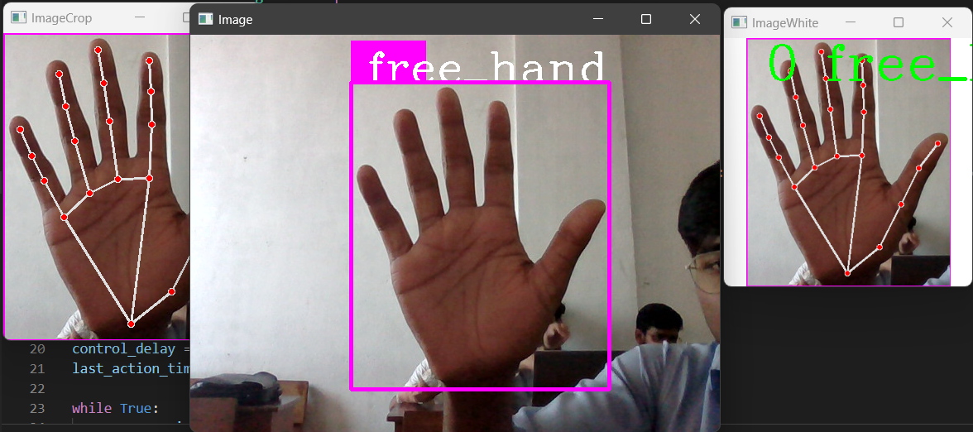
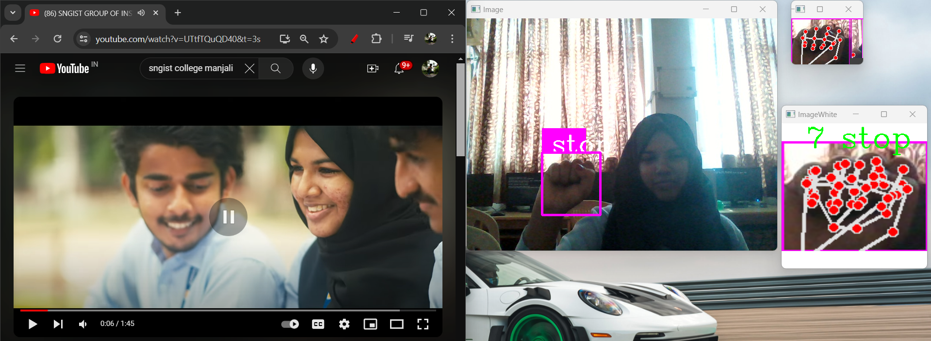
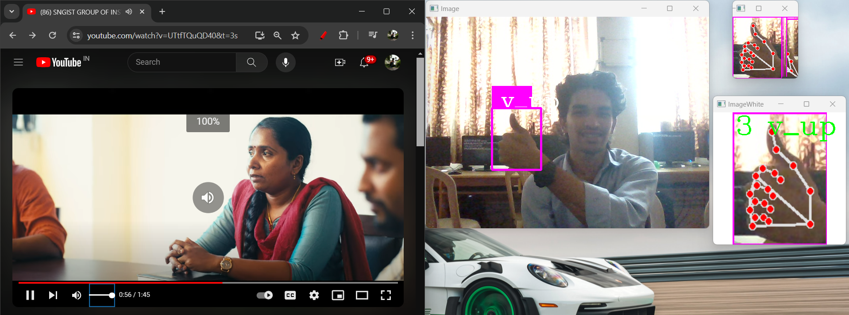
Hand Gesture YouTube Control System
22
8. SCREENSHOTS
8.1 Sample Screenshots
+
Fig.1 Screenshot 1
Fig.2 Screenshot 2
Fig.3 Screenshot 3

Slide 30
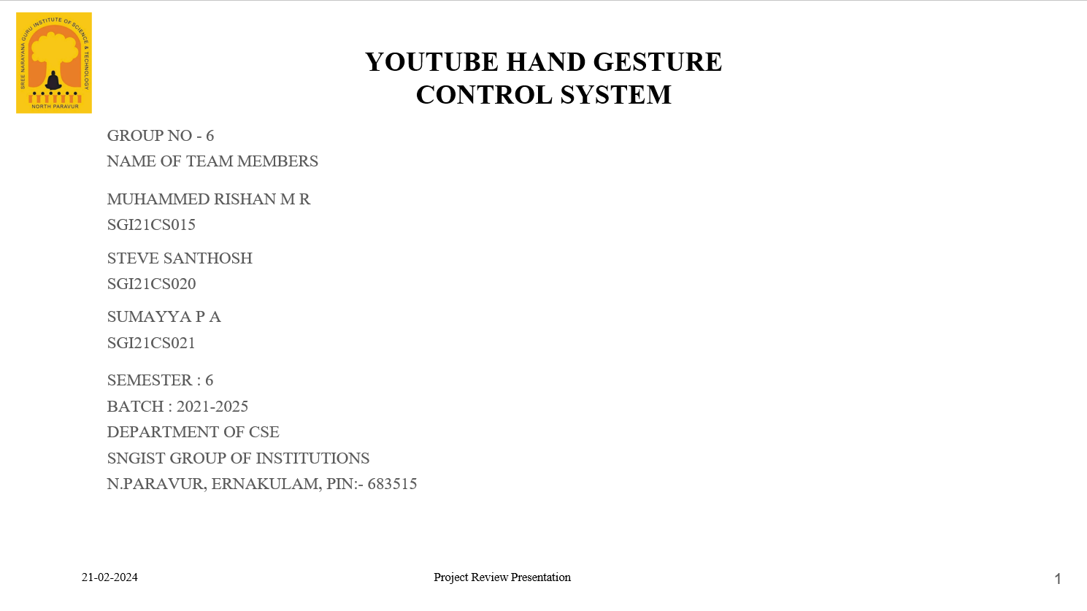
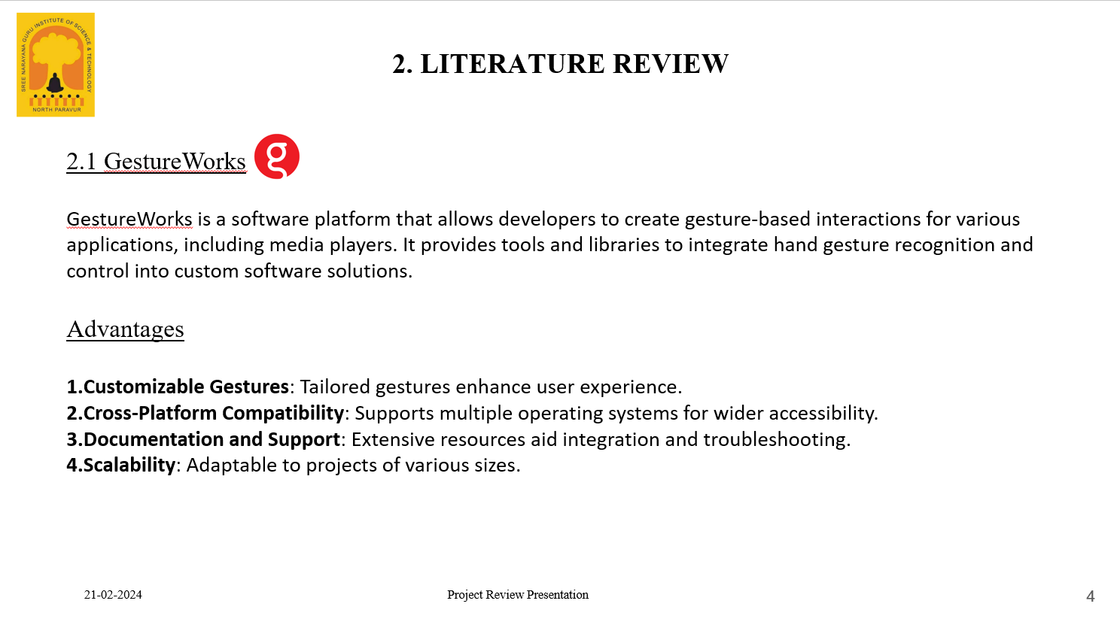
Hand Gesture YouTube Control System
23
8.2 Sample Slides
+
Fig.4 Sample Slide 1
Fig.5 Sample Slide 2

Slide 31
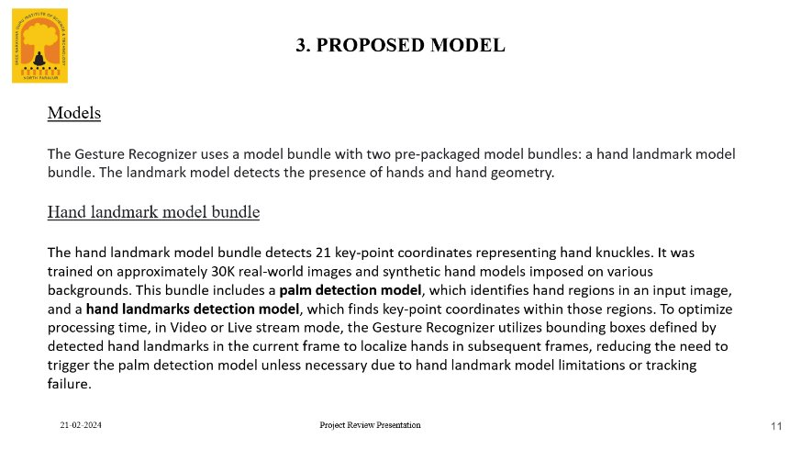
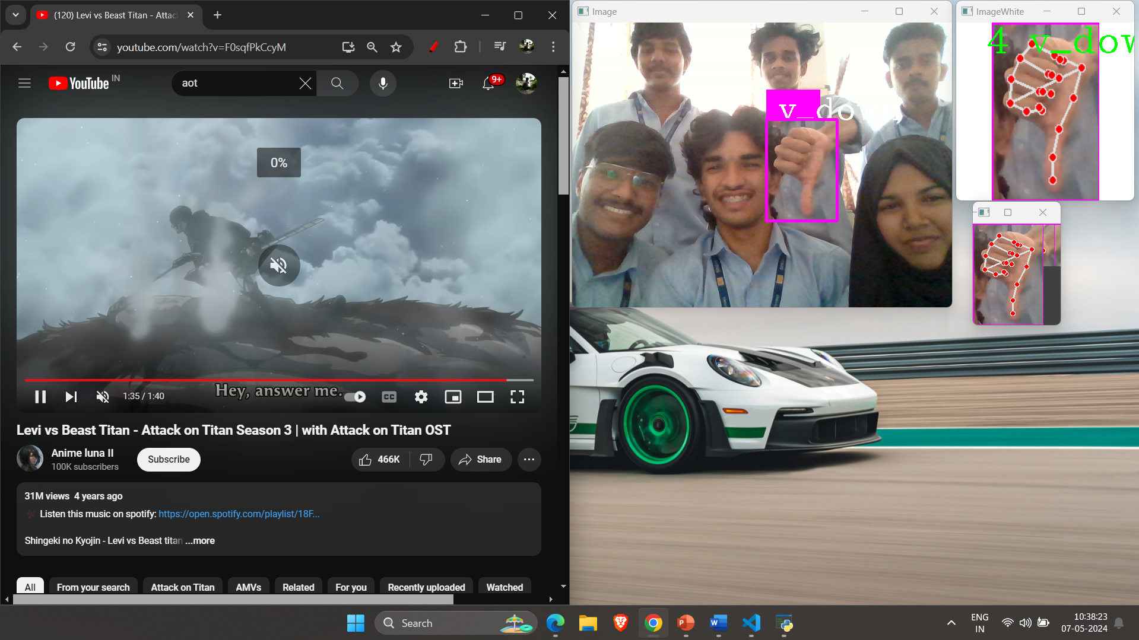
Hand Gesture YouTube Control System
24
+
Fig.6 Sample Slide 3
Fig.7 Screenshot 4

Slide 32
Hand Gesture YouTube Control System
25
9. CONCLUSION
In a world where digital interactions have become integral to our daily lives, the Hand Gesture Recognition and Control System represents a step forward in enhancing how we interface with technology. The project successfully demonstrates the potential of computer vision and machine learning in recognizing and interpreting hand gestures. By enabling users to control their computers through intuitive hand movements, the system offers an alternative, more accessible means of computer interaction. This project, however, is just the beginning of a journey into the realm of gesture-based computing. Future developments may include expanding the set of recognized gestures, improving accuracy, and enhancing compatibility with various software applications. Additionally, the system's performance and user experience can be optimized further. The Hand Gesture Recognition and Control System serves as an illustrative example of how technology can adapt to human behavior, ultimately making digital interactions more natural and efficient. It underscores the ongoing evolution of user interfaces, pointing to a future where complex tasks can be performed effortlessly with just a wave of the hand.

Slide 33
Hand Gesture YouTube Control System
26
10. FUTURE ENHANCEMENTS
To enhance this project further, here are some potential areas of future development:
• Real-Time Feedback: Implement real-time feedback mechanisms to provide users with visual or auditory cues during gesture recognition. This enhances the user experience by confirming that the system has recognized the intended gesture.
• Customizable Gestures: Allow users to define and customize their own gestures. Providing an interface to create custom gesture-action mappings can make the system highly adaptable to individual preferences and needs.
• Multi-Device Integration: Extend the project's capabilities to support integration with various devices, such as smart TVs and gaming consoles. This opens up new opportunities for controlling a wide range of digital content beyond YouTube.
• Multi-Model Interaction: Explore combining hand gestures with voice recognition or other input modalities for a more comprehensive and flexible interaction experience. This can increase the range of actions users can perform.
• Privacy and Security: Address potential privacy and security concerns related to the use of webcams for gesture recognition. Implement robust security measures to protect user data and ensure privacy compliance.
• Scalability: Plan for scalability to accommodate a growing user base. Ensure that the project can handle increased load and user demand without compromising performance.
• Usability Testing: Conduct extensive usability testing with a diverse group of users to gather feedback and identify areas of improvement. User feedback is invaluable for refining the project and ensuring it meets the needs of its target audience.

Slide 34
Hand Gesture YouTube Control System
27
• Educational and training application: Explore applications beyond entertainment, such as using the technology for educational purposes or training simulations. The project's gesture recognition capabilities can be leveraged for interactive learning experiences.
• Cross-Platform Integration: Work on integrating the gesture recognition system into a variety of platforms and applications, making it a standard option for users across different environments.
• Open Source and Community Contributions: Consider releasing the project as open source, encouraging developers and the community to contribute, improve, and adapt it for various purposes. Open source projects often benefit from collaborative innovation.
• Research and Innovation: Stay up-to-date with the latest advancements in computer vision, machine learning, and human-computer interaction. Continuously explore cutting-edge technologies to keep the project at the forefront of gesture recognition.
The project's future work should be guided by the goal of improving user experience, increasing accessibility, and expanding its potential applications. These points provide a roadmap for enhancing the project's capabilities, addressing challenges, and ensuring its continued relevance in the evolving field of gesture-based interaction.

Slide 35
Hand Gesture YouTube Control System
28
11. REFERENCES
Garg, R. K., & Somayaji, A. (2014). Gesture recognition for human-computer interaction: A review. International Journal of Intelligent Systems and Applications, 6(3), 1-14.
• Gonzalez-Diaz, I., Rangel, J. A., & Herrera, G. J. (2018). Real-time hand gesture recognition system for human-robot interaction. Sensors, 18(2), 471.
• OpenCV. (2021). OpenCV: Open Source Computer Vision Library. [https://opencv.org/]
• TensorFlow. (2021). TensorFlow: An Open-Source Machine Learning Framework. [https://www.tensorflow.org/]
• PyAutoGUI. (2021). PyAutoGUI: Python Automated GUI. [https://pyautogui.readthedocs.io/]
• cvzone. (2021). cvzone: Computer Vision Tools for Developers. [https://github.com/cvzone/cvzone]

